Slide 1

Patient Bed Assignment problem Mimmo CONFORTI
LM-41 Medicina TD – PGSS 23/24

Slide 2
Problem statement

Slide 3




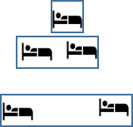
Patient admission and room assignment problems
Patient admission problem
when
where
Patient bed assignment problem
Fixed admission date and LOS
when
where
Patient admission problem under uncertainty
Interval of admission dates

Slide 4
Problem statement
Patient bed assignment problem consists in assigning elective patients to beds by taking into account several requirements.
Offline scheduling problems:
patients need to be assigned to a bed/room
admission and discharge dates are known
Rosita

Slide 5
Department: a hospital has a number of departments. A hospital department has a number of specialties
Specialism: department specialties have different expertise in treating certain pathologies. The department should have high expertise for the specialty of patients assigned to their rooms. Low expertise is penalized
Rooms: Every room belongs to a unique department
Room Capacity: every room has a number of beds
Room Equipment: some beds have equipment (e.g. oxygen, monitoring).
Room Age Policy (e.g. paediatric and geriatric departments)
Room Gender Policy:
restricted only to male or female patients (restricted gender policy)
dependent gender policy (only patients with the same gender of the first assigned patient can be assigned to)
rooms without a gender policy can be assigned both to female and male at the same time

Slide 6
Patients: A set of elective patients must be assigned to hospital rooms in a defined planning period. Patients are characterized by
age
gender
pathology
mandatory equipment
preferred equipment
room type preference (single, double, or ward)
Every patient should be treated in a room in correspondence with his/her characteristics otherwise there is a penalization
Patients should not change their bed during the stay. A change of bed is a transfer and it is penalized
Admission-discharge day are patient dependent

Slide 7
Resources
Departments
Specialties
Levels of expertise in treating a disease
Rooms category
Room capacity
Rooms equipment
Room gender policy
Room age policy
Demand
Patients (female and male)
Patient's specialties
LOS
Preferred room capacity
Patient's gender
Patient's age
Patient’s equipment
Table 2 – Sets and parameters

Slide 8
Objective
Assigning patients to beds according to quality of care and patients' preferences
Constraints (hard)
every patient has to be assigned to a bed over his/her stay
patient mandatory equipment requirement has to be satisfied by assigning him/her to a well-equipped room
patients have to be assigned consistently to rooms with defined age policies
each patient has to be assigned to a room such that the defined gender policy (restricted or dependent) is satisfied
room capacity constraint.
Constraints (Soft): w_{pr} assignment cost
Violations on a patient not being assigned to a room of the correct specialty
Violations on patient not being assigned to a room with preferred equipment
Violations on patient not being assigned to a department with the right specialty
Violations on room category preference

Slide 9
Optimization model

Slide 10
Decision variables
1 if patient p ∈ P is assigned to room r ∈ R during LOS
X_{pr} =
0 otherwise
1 if at least a female is in room r ∈ R_{dgp} on day d ∈ D
f_{rd} =
0 otherwise
1 if at least a male is in room r ∈ R_{dgp} on day d ∈ D
m_{rd} =
0 otherwise

Slide 11
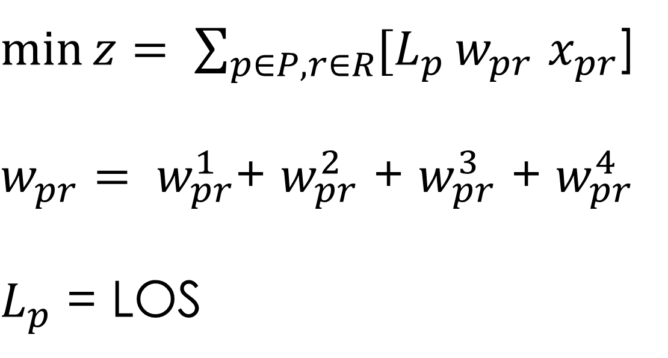
Objective function
$\min{z= \sum_{p∈P, r∈R}{{[L}_{p}}}w_{pr}$ $x_{pr}$]
$w_{pr}= w_{pr}^{1}$+ $w_{pr}^{2}$ + $w_{pr}^{3}$ + $w_{pr}^{4}$
$L_{p}$ = LOS

Slide 12
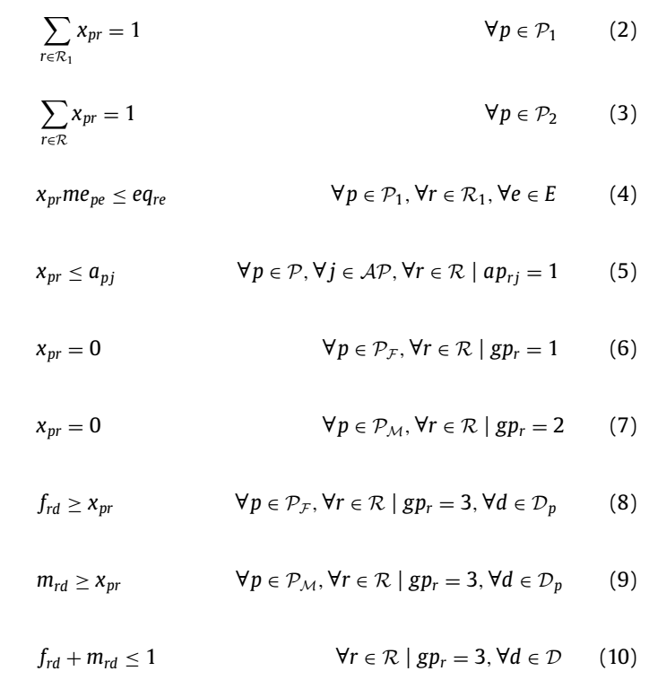
Room assignment
Room equipment
Age policy
Gender policy

Slide 13
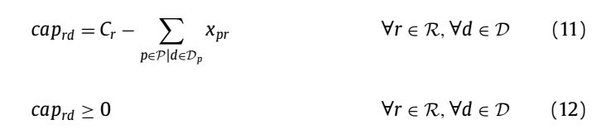
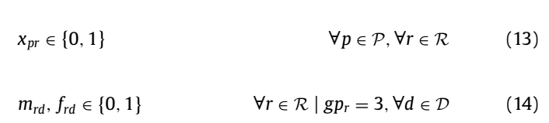
Room capacity

Slide 14
Results

Slide 15
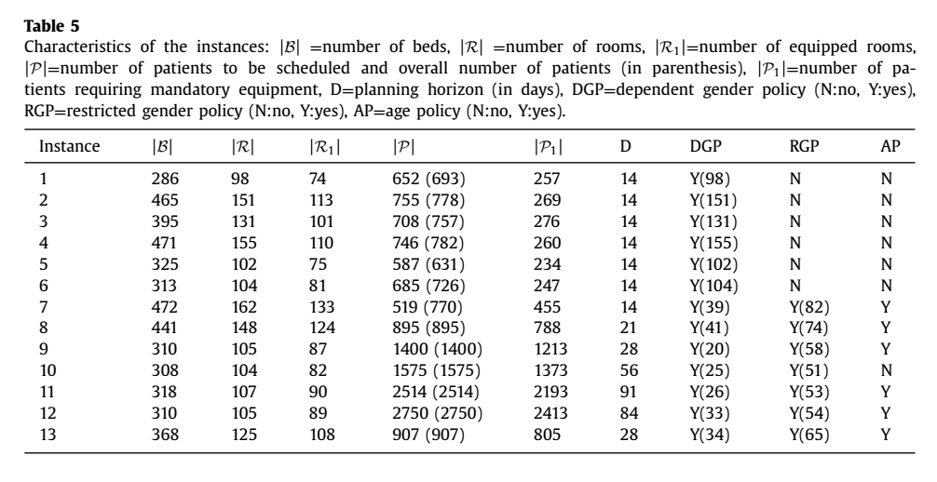

Slide 16
